Slide 1
Random variables - Continued
Continuous Random Variables
Joint Distributions

Slide 2
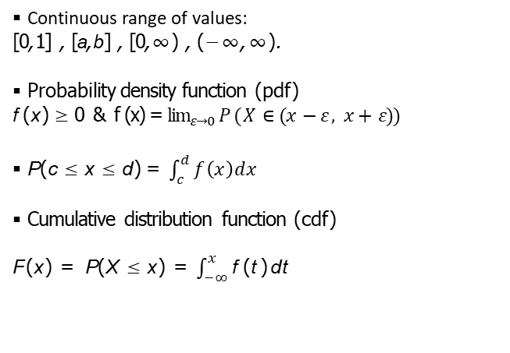
Continuous Random Variables
Continuous range of values:
[0, 1] , [a, b] , [0, ∞) , (−∞, ∞).
Probability density function (pdf)
f (x ) ≥ 0 & f (x) = $\lim_{ε→0}{P ( X ∈(x −ε , x+ ε}))$
P (c ≤ x ≤ d ) = $\int_{c}^{d}{f\left(x\right)dx}$
Cumulative distribution function (cdf)
F (x ) = P (X ≤ x ) = $\int_{−∞}^{x}{\text{f} \text{(}\text{t}\text{)} \text{d}\text{t}}$

Slide 3
Visualization
f (x)
P (c ≤ X ≤ d)
x
c
d
pdf and probability
f (x)
F (x) = P (X ≤ x)
x
x
pdf and cdf

Slide 4
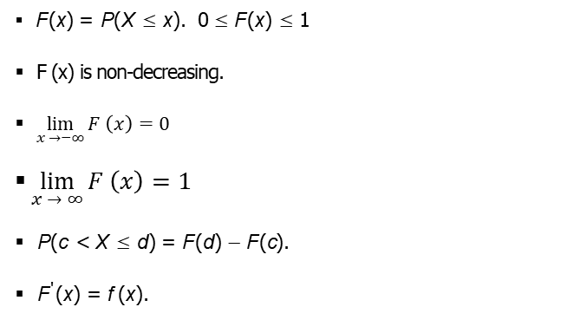
Properties of the cdf
F (x ) = P (X ≤ x ). 0 ≤ F (x ) ≤ 1
F (x) is non-decreasing.
$\lim_{x →−∞}{F \left(x\right)=0}$
$\lim_{x → ∞}{F \left(x\right)=1}$
P (c < X ≤ d ) = F (d ) − F (c ).
F '(x ) = f (x ).

Slide 5
Concept Question 1
1. Suppose X has range [0, 2] and pdf f (x ) = cx ².
What is the value of c .
Compute the cdf F (x ).
Compute P (1 ≤ X ≤ 2).
2. Suppose Y has range [0, b] and cdf F (y ) = y ²/9.
What is b?
Find the pdf of Y .

Slide 6
Concept question 2
Suppose X is a continuous random variable.
What is P (-a ≤ X ≤ a)?
What is P (X = 0)?
Does P (X = a) = 0 mean X never equals a?

Slide 7
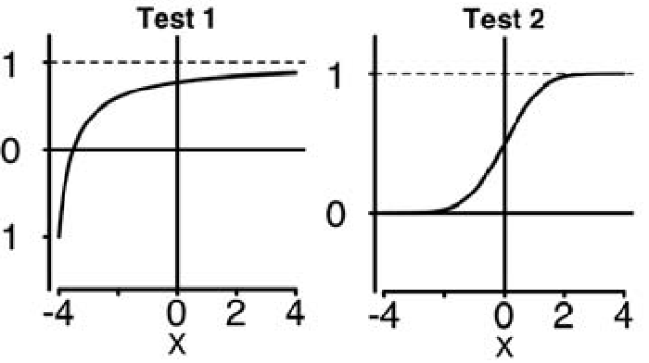
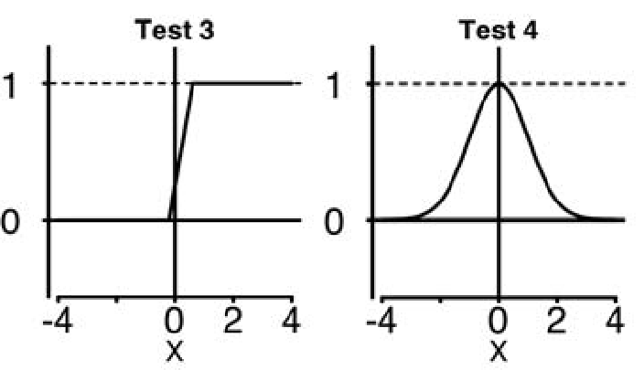
Concept question 3
Which of the following are graphs of valid cumulative distribution functions?

Slide 8
Exponential Random Variables
Parameter: | λ (called the rate parameter).
Range: | [0, ∞).
Notation: | exponential(λ) or exp(λ).
Density: | f (x ) = λe^{−λx} | for 0 ≤ x .
Models: Waiting time
P (3 < X < 7)
.1
F (x) = 1 − e^{−x/10}
1
f (x) = λe^{−λx}
x
x
2 4 6 8 10 12 14 16 2 4 6 8 10 12 14 16

Slide 9
Concept question 4
I’ve noticed that taxis drive past the IIT kgp campus on the average of once every 10 minutes. Suppose time spent waiting for a taxi is modeled by an exponential random variable.
X ∼ Exponential(1/10); | 1 f (x ) = e^{−x/10} 10
(a) Sketch the pdf of this distribution
Shade the region which represents the probability of waiting between 3 and 7 minutes
Compute the probability of waiting between between 3 and 7 minutes for a taxi
Compute and sketch the cdf.

Slide 10
Joint Distributions, Independence Covariance and Correlation
X\Y | 1 | 2 | 3 | 4 | 5 | 6
1 | 1/36 | 1/36 | 1/36 | 1/36 | 1/36 | 1/36
2 | 1/36 | 1/36 | 1/36 | 1/36 | 1/36 | 1/36
3 | 1/36 | 1/36 | 1/36 | 1/36 | 1/36 | 1/36
4 | 1/36 | 1/36 | 1/36 | 1/36 | 1/36 | 1/36
5 | 1/36 | 1/36 | 1/36 | 1/36 | 1/36 | 1/36
6 | 1/36 | 1/36 | 1/36 | 1/36 | 1/36 | 1/36

Slide 11
Joint Distributions
X and Y are jointly distributed random variables. Discrete: Probability mass function (pmf): p(x_{i} , y_{j} )
Continuous: probability density function (pdf): f (x, y )
Both: cumulative distribution function (cdf): F (x, y )
= P(X ≤ x, Y ≤ y )

Slide 12
Discrete joint pmf: example 1
Roll two dice: X = # on ﬁrst die, Y = # on second die
X takes values in 1, 2, . . . , 6, Y takes values in 1, 2, . . . , 6
Joint probability table:
X\Y | 1 | 2 | 3 | 4 | 5 | 6
1 | 1/36 | 1/36 | 1/36 | 1/36 | 1/36 | 1/36
2 | 1/36 | 1/36 | 1/36 | 1/36 | 1/36 | 1/36
3 | 1/36 | 1/36 | 1/36 | 1/36 | 1/36 | 1/36
4 | 1/36 | 1/36 | 1/36 | 1/36 | 1/36 | 1/36
5 | 1/36 | 1/36 | 1/36 | 1/36 | 1/36 | 1/36
6 | 1/36 | 1/36 | 1/36 | 1/36 | 1/36 | 1/36
pmf: p(i, j) = 1/36 for any i and j between 1 and 6.

Slide 13
Discrete joint pmf: example 2
Roll two dice: X = # on ﬁrst die, T = total on both dice
X\T | 2 | 3 | 4 | 5 | 6 | 7 | 8 | 9 | 10 | 11 | 12
1 | 1/36 | 1/36 | 1/36 | 1/36 | 1/36 | 1/36 | 0 | 0 | 0 | 0 | 0
2 | 0 | 1/36 | 1/36 | 1/36 | 1/36 | 1/36 | 1/36 | 0 | 0 | 0 | 0
3 | 0 | 0 | 1/36 | 1/36 | 1/36 | 1/36 | 1/36 | 1/36 | 0 | 0 | 0
4 | 0 | 0 | 0 | 1/36 | 1/36 | 1/36 | 1/36 | 1/36 | 1/36 | 0 | 0
5 | 0 | 0 | 0 | 0 | 1/36 | 1/36 | 1/36 | 1/36 | 1/36 | 1/36 | 0
6 | 0 | 0 | 0 | 0 | 0 | 1/36 | 1/36 | 1/36 | 1/36 | 1/36 | 1/36

Slide 14
Continuous joint distributions
X takes values in [a, b],Y takes values in [c, d ]
(X , Y ) takes values in [a, b] × [c, d ].
Joint probability density function (pdf) f (x, y )
f (x, y ) dx dy is the probability of being in the small square.
y
d
Prob. = f (x, y) dx dy
dy
dx
c
x
a
b

Slide 15
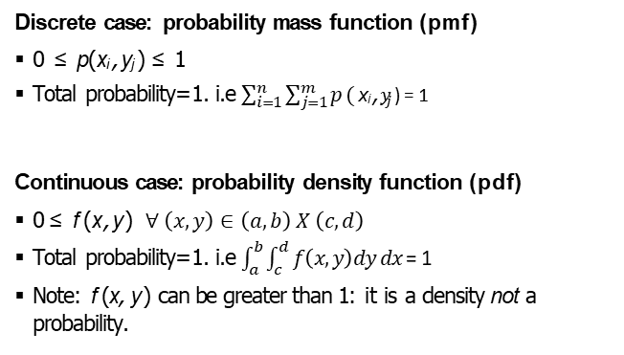
Properties of the joint pmf and pdf
Discrete case: probability mass function (pmf)
0 ≤ p(x_{i} , y_{j} ) ≤ 1
Total probability=1. i.e $\sum_{i=1}^{n}{\sum_{j=1}^{m}{p (}}$ x_{i} , $y_{j}$ ) = 1
Continuous case: probability density function (pdf)
0 ≤ f (x, y ) $∀ \left(x,y\right)∈\left(a,b\right) X \left(c,d\right)$
Total probability=1. i.e $\int_{a}^{b}{\int_{c}^{d}{f\left(x,y\right)dy dx }}$= 1
Note: f (x, y ) can be greater than 1: it is a density not a probability.

Slide 16
Discrete Events – Example
Roll two dice: X = # on ﬁrst die, Y = # on second die. Consider the event: A = ‘Y − X ≥ 2’
Describe the event A and ﬁnd its probability.
answer: We can describe A as a set of (X , Y ) pairs:
A = {(1, 3), (1, 4), (1, 5), (1, 6), (2, 4), (2, 5), (2, 6), (3, 5), (3, 6), (4, 6)}.
Or we can visualize it by shading the table:
X\Y | 1 | 2 | 3 | 4 | 5 | 6
1 | 1/36 | 1/36 | 1/36 | 1/36 | 1/36 | 1/36
2 | 1/36 | 1/36 | 1/36 | 1/36 | 1/36 | 1/36
3 | 1/36 | 1/36 | 1/36 | 1/36 | 1/36 | 1/36
4 | 1/36 | 1/36 | 1/36 | 1/36 | 1/36 | 1/36
5 | 1/36 | 1/36 | 1/36 | 1/36 | 1/36 | 1/36
6 | 1/36 | 1/36 | 1/36 | 1/36 | 1/36 | 1/36
P(A) = sum of probabilities in shaded cells = 10/36.

Slide 17
Continuous events - Example
Suppose (X , Y ) takes values in [0, 1] × [0, 1]. Uniform density f (x, y ) = 1. Visualize the event ‘X > Y ’ and ﬁnd its probability.
answer:
y
1
‘X > Y ’
x
1
The event takes up half the square. Since the density is uniform this is half the probability. That is, P(X > Y ) = 0.5

Slide 18
Cumulative distribution function
y x
F (x, y ) = P(X ≤ x, Y ≤ y ) =
∫ ∫
f (u, v ) du dv.
c a
∂²F
f (x, y ) =
(x, y ).
∂x∂y
Properties
F (x, y ) is non-decreasing. That is, as x or y increases F (x, y ) increases or remains constant.
F (x, y ) = 0 at the lower left of its range.
If the lower left is (−∞, −∞) then this means
lim F (x, y ) = 0.
(x,y )→(−∞,−∞)
F (x, y ) = 1 at the upper right of its range.

Slide 19
Marginal pmf and pdf
Roll two dice: X = # on ﬁrst die, T = total on both dice.
The marginal pmf of X is found by summing the rows. The marginal pmf of T is found by summing the columns
X\T | 2 | 3 | 4 | 5 | 6 | 7 | 8 | 9 | 10 | 11 | 12
1 | 1/36 | 1/36 | 1/36 | 1/36 | 1/36 | 1/36 | 0 | 0 | 0 | 0 | 0
2 | 0 | 1/36 | 1/36 | 1/36 | 1/36 | 1/36 | 1/36 | 0 | 0 | 0 | 0
3 | 0 | 0 | 1/36 | 1/36 | 1/36 | 1/36 | 1/36 | 1/36 | 0 | 0 | 0
4 | 0 | 0 | 0 | 1/36 | 1/36 | 1/36 | 1/36 | 1/36 | 1/36 | 0 | 0
5 | 0 | 0 | 0 | 0 | 1/36 | 1/36 | 1/36 | 1/36 | 1/36 | 1/36 | 0
6 | 0 | 0 | 0 | 0 | 0 | 1/36 | 1/36 | 1/36 | 1/36 | 1/36 | 1/36
 |  |  | p(x_{i})
 |  |  | 1/6
 |  |  | 1/6
 |  |  | 1/6
 |  |  | 1/6
 |  |  | 1/6
 |  |  | 1/6
p(t_{j} ) 1/36 2/36 3/36 4/36 5/36 6/36 5/36 | 4/36 3/36 | 2/36 1/36 | 1
For continuous distributions the marginal pdf f_{X} (x ) is found by integrating out the y . Likewise for f_{Y} (y ).

Slide 20
Concept question 5
Suppose X and Y are random variables and (X , Y ) takes values in [0, 1] × [0, 1].
3
the pdf is (x ² + y ²).
2
Show f (x, y ) is a valid pdf.
Visualize the event A = ‘X > 0.3 and Y
probability.
Find the cdf F (x, y ).
1
2
> 0.5’. Find its
3
Find the marginal pdf f_{X} (x ). Use this to ﬁnd P(X < 0.5). Use the cdf F (x, y ) to ﬁnd the marginal cdf F_{X} (x ) and
P(X < 0.5).
See next slide
4
5
6

Slide 21
From the following table compute F (3.5, 4).
Concept question 6
X\Y | 1 | 2 | 3 | 4 | 5 | 6
1 | 1/36 | 1/36 | 1/36 | 1/36 | 1/36 | 1/36
2 | 1/36 | 1/36 | 1/36 | 1/36 | 1/36 | 1/36
3 | 1/36 | 1/36 | 1/36 | 1/36 | 1/36 | 1/36
4 | 1/36 | 1/36 | 1/36 | 1/36 | 1/36 | 1/36
5 | 1/36 | 1/36 | 1/36 | 1/36 | 1/36 | 1/36
6 | 1/36 | 1/36 | 1/36 | 1/36 | 1/36 | 1/36

Slide 22
Independence
Events A and B are independent if
P(A ∩ B) = P(A)P(B).
Random variables X and Y are independent if
F (x, y ) = F_{X} (x )F_{Y} (y ).
Discrete random variables X and Y are independent if
p(x_{i} , y_{j} ) = p_{X} (x_{i} )p_{Y} (y_{j} ).
Continuous random variables X and Y are independent if
f (x, y ) = f_{X} (x )f_{Y} (y ).

Slide 23
Concept question 7: Independence
Roll two dice: X = value on ﬁrst, Y = value on second
X\Y | 1 | 2 | 3 | 4 | 5 | 6 | p(x_{i})
1 | 1/36 | 1/36 | 1/36 | 1/36 | 1/36 | 1/36 | 1/6
2 | 1/36 | 1/36 | 1/36 | 1/36 | 1/36 | 1/36 | 1/6
3 | 1/36 | 1/36 | 1/36 | 1/36 | 1/36 | 1/36 | 1/6
4 | 1/36 | 1/36 | 1/36 | 1/36 | 1/36 | 1/36 | 1/6
5 | 1/36 | 1/36 | 1/36 | 1/36 | 1/36 | 1/36 | 1/6
6 | 1/36 | 1/36 | 1/36 | 1/36 | 1/36 | 1/36 | 1/6
p(y_{j} ) | 1/6 | 1/6 | 1/6 | 1/6 | 1/6 | 1/6 | 1
Are X and Y independent?
1. Yes
2. No

Slide 24
Concept question 8: independence II
Roll two dice:
X = value on ﬁrst,
T = sum
X\T | 2 | 3 | 4 | 5 | 6 | 7 | 8 | 9 | 10 | 11 | 12 | p(x_{i})
1 | 1/36 | 1/36 | 1/36 | 1/36 | 1/36 | 1/36 | 0 | 0 | 0 | 0 | 0 | 1/6
2 | 0 | 1/36 | 1/36 | 1/36 | 1/36 | 1/36 | 1/36 | 0 | 0 | 0 | 0 | 1/6
3 | 0 | 0 | 1/36 | 1/36 | 1/36 | 1/36 | 1/36 | 1/36 | 0 | 0 | 0 | 1/6
4 | 0 | 0 | 0 | 1/36 | 1/36 | 1/36 | 1/36 | 1/36 | 1/36 | 0 | 0 | 1/6
5 | 0 | 0 | 0 | 0 | 1/36 | 1/36 | 1/36 | 1/36 | 1/36 | 1/36 | 0 | 1/6
6 | 0 | 0 | 0 | 0 | 0 | 1/36 | 1/36 | 1/36 | 1/36 | 1/36 | 1/36 | 1/6
p(y_{j} ) 1/36 2/36 |  |  | 3/36 4/36 5/36 |  |  | 6/36 5/36 |  | 4/36 3/36 2/36 1/36 |  |  |  | 1
Are X and Y independent?
1. Yes
2. No

Slide 25
Concept Question 9
Among the following pdf’s which are independent? (Each of the
∫ ∫
ranges is a rectangle chosen so that f (x, y ) dx dy = 1.)
(i) f (x, y ) = 4x ²y ³.
(ii) f (x, y ) = ¹ (x ³y + xy ³).
2
(iii) f (x, y ) = 6e^{−3x−2y}
Put a 1 for independent and a 0 for not-independent.
(a) 111 | (b) 110 | (c) 101 | (d) 100
(e) 011 | (f) 010 | (g) 001 | (h) 000

Slide 26
Covariance
Measures the degree to which two random variables vary together,
e.g. height and weight of people.
X , Y random variables with means µ_{X} and µ_{Y}
Cov(X , Y ) = E ((X − µ_{X} )(Y − µ_{Y} )).

Slide 27
Properties of covariance
Properties
1. Cov(aX + b, cY + d ) = acCov(X , Y ) for constants a, b, c, d . 2. Cov(X₁ + X₂, Y ) = Cov(X₁, Y ) + Cov(X₂, Y ).
Cov(X , X ) = Var(X )
Cov(X , Y ) = E (XY ) − µ_{X} µ_{Y} .
If X and Y are independent then Cov(X , Y ) = 0.
Warning: The converse is not true, if covariance is 0 the variables might not be independent.

Slide 28
Concept question 10
Suppose we have the following joint probability table.
p(y_{j} ) 1/2
1/2
p(x_{i}) 1/4 1/2 1/4 1
At your table work out the covariance Cov(X , Y ).
Because the covariance is 0 we know that X and Y are independent
1. True 2. False
Key point: covariance measures the linear relationship between X and
Y . It can completely miss a quadratic or higher order relationship.
Y \X | -1 | 0 | 1
0 | 0 | 1/2 | 0
1 | 1/4 | 0 | 1/4

Slide 29
Concept question 11
Flip a fair coin 12 times.
Let X = number of heads in the ﬁrst 7 ﬂips
Let Y = number of heads on the last 7 ﬂips. Compute Cov(X , Y ),

Slide 30
Correlation
Like covariance, but removes scale.
The correlation coeﬃcient between X and Y is deﬁned by
Cov(X , Y )
Cor(X , Y ) = ρ =
.
σ_{X} σ_{Y}
Properties:
ρ is the covariance of the standardized versions of X
and Y .
ρ is dimensionless (it’s a ratio).
−1 ≤ ρ ≤ 1. ρ = 1 if and only if Y = aX + b with
a > 0 and ρ = −1 if and only if Y = aX + b with a < 0.

Slide 31
Real-life correlations
Over time, amount of Ice cream consumption is correlated with number of pool drownings.
In 1685 (and today) being a student is the most dangerous profession.
In 90% of bar ﬁghts ending in a death the person who started the ﬁght died.
Hormone replacement therapy (HRT) is correlated with a lower rate of coronary heart disease (CHD).

Slide 32
Correlation is not causation
Edward Tufte: ”Empirically observed covariation is a necessary but not suﬃcient condition for causality.”

Slide 33
Overlapping sums of uniform random variables
We made two random variables X and Y from overlapping sums of uniform random variables
For example:
X = X₁ + X₂ + X₃ + X₄ + X₅
Y = X₃ + X₄ + X₅ + X₆ + X₇
These are sums of 5 of the X_{i} with 3 in common.
If we sum r of the X_{i} with s in common we name it (r , s). Below are a series of scatterplots produced using R.

Slide 34
Scatter plots
(1, 0) cor=0.00, sample_cor=−0.07
(2, 1) cor=0.50, sample_cor=0.48
●● ● ● ●
● ●
2.0
●
●
●● ●●●● ●●● ●● ●●● ● ● ●●
● ● ●●● ● ● ●● ● ● ● ●
● ● ● ●
● ●● ● ●● ● ● ●● ● ●● ● ● ● ● ● ● ● ●●
●
● ● ● ●
● ● ●● ●●
● ● ●●
●
● ●
●● ● ● ● ●● ● ●
● ● ●● ●
● ●● ●● ● ● ●
●●●
●● ●● ● ●● ● ● ●
●●●● ●● ●●● ● ● ●●●● ●
● ●
●●● ●●●
●● ●
● ●● ● ● ●
●●
● ●
●
● ● ●● ● ●
● ●● ● ● ● ● ●
0.8
●● ● ● ● ●● ● ● ●
● ● ● ● ● ● ● ● ● ● ●
●
● ● ● ●
● ● ● ● ● ● ●
● ● ● ● ● ●
1.5
● ● ●● ●
● ●● ● ● ● ●
● ● ●● ● ● ● ● ●
● ●
● ● ● ● ●●● ●●● ● ● ● ●
●●● ● ● ● ● ●
●● ●●●● ●● ● ●● ●●
●● ●●
● ● ●●● ● ● ●●● ● ● ● ● ●
●● ● ●● ● ● ●●●
● ● ● ● ●● ●●●●●●
●●●●●●● ●●● ● ●●● ● ●● ●● ●●●● ●● ●
●● ● ●● ● ● ● ● ● ●● ●●●●●
● ● ●●
● ●● ● ●
● ●
●● ● ● ● ● ● ●● ●● ●● ● ●● ●●● ●
● ●●● ● ● ●● ●● ●●● ●●
● ●
● ●● ●● ●●●
● ●
● ●● ●
●● ●● ● ●● ● ●●● ●●● ● ●●●● ●●●●● ●
● ● ● ●●
●
● ●● ●
●●
● ● ● ● ● ● ●
● ● ●
● ●● ● ● ● ●●●●●● ●●●● ● ● ●● ● ● ● ● ● ●
●● ● ●
●●●● ●
●
● ● ● ●●●●● ● ●●●●● ●● ● ●●● ●●●
● ●● ●●
● ●●●● ●● ●●●●●● ● ●● ● ●
● ●● ● ● ●
● ● ● ● ● ● ● ● ●●
●
● ● ●
●
● ● ● ●
● ● ● ●● ● ●●●●● ●● ● ● ● ● ● ●
● ● ●●
● ●● ● ● ●● ● ●
● ● ●● ● ● ● ● ● ● ● ●
● ● ●
● ●●● ● ● ● ● ● ● ●●● ●●●●●●●
●
● ● ● ● ● ● ●
●● ●● ●
● ● ●
● ● ● ● ● ● ●●●● ● ●●● ●●● ●
●● ● ● ●●
● ●●●
● ●
●● ●● ● ● ●●● ●● ●●
●
● ● ●● ●●● ●●●● ● ●●●●● ● ● ●● ●● ● ●● ● ● ●●
●
● ●●●● ●●
● ●● ● ●
● ●
0.5 1.0
●● ●● ●●●●● ● ●● ● ●●● ●●●●●●● ●●● ●
● ● ●
●●
● ● ● ● ●● ●
●● ●
●
●● ●● ● ●●●●
● ● ● ● ●●●●●● ●●●● ●●● ●● ●●●● ● ● ●● ●●
y
●● ● ● ●
●●● ● ● ●●
●● ●●● ● ●
●●● ● ●●
y
● ● ● ● ● ●● ●●● ●●●●● ●●● ●●● ●● ●●●● ●●
●● ●● ● ● ●● ● ●● ● ●● ●
●
● ● ● ●●●●● ●● ● ●●●●● ● ● ●●●●● ● ● ● ●
●
●
● ●● ● ● ● ●
● ● ●
●● ● ●● ● ●● ●● ●●●●● ●●●● ●●●●●● ● ● ●● ●● ● ●
● ● ● ●● ● ● ●● ● ● ● ● ●
● ● ● ●●●● ●
●●● ● ● ● ●●●●●●● ●● ●● ● ● ●●●● ● ●● ● ● ● ●● ●
0.4
●
●● ● ● ●
● ● ●●● ●● ●●● ●●● ●●● ● ● ●● ● ● ●● ● ●
●● ●● ● ●●
● ●
● ●
●●●●
● ● ●●
● ●● ●
●
●●
● ● ●● ●●● ●● ●● ● ● ●●●● ● ● ●● ●●● ●
● ●
● ●● ●
● ● ●●
● ●●●● ●● ● ● ● ● ● ● ●
●● ● ● ● ●●●
● ● ●
● ●● ●● ● ●●●
● ● ●●●● ● ●
●● ● ●
● ●● ●● ● ●●● ●● ●● ●●●●●● ● ●●● ●●●● ● ●
● ● ●●●●● ● ●
●
●●
●
●● ● ●● ● ●●
● ● ● ●● ●● ●●
●● ●
● ●● ●●●●● ●● ● ● ● ●● ●
● ●
● ● ●
●
●
●● ● ● ●● ●●● ● ● ● ● ● ● ●●
●
●● ● ● ● ● ●
●
● ● ●● ● ● ●●
●●●
● ●
●
● ●
●●
●●● ● ● ●●
● ●● ● ● ●● ● ●●● ●
●
● ● ● ●●
● ●
● ● ●●● ● ● ●●
●●
●●● ●●●● ●● ● ●● ●
● ●
● ●● ●●●
●
● ● ● ●●● ●
● ●● ● ●● ●● ● ● ●●● ● ●●
● ● ● ● ●
●
● ●
●● ● ● ● ●●
●
●●
● ●●
● ● ●
● ●● ● ●● ● ● ●●●●● ●●
● ● ● ● ● ●
●● ● ● ●
●
● ●
● ● ●● ● ●
●●●●● ●●●● ●● ●●
● ● ●
●●●●● ●
●● ●●●
●
● ● ●● ● ●● ● ● ● ●
●●● ●●
● ● ●
● ● ●
●● ● ● ● ●● ● ● ● ● ●
● ●● ● ●● ●●● ● ●●●●●●● ●● ●
● ●
● ●
●
●
●●● ● ●● ● ●
● ● ● ●● ● ●● ●●● ●
● ● ●●● ●●● ● ●● ●● ● ●● ●● ● ●●
● ● ● ●
● ● ●●●
● ● ● ●
●
● ● ●●● ● ● ● ● ●● ●●
●●● ●●
● ● ●● ● ● ●●●●●●
● ●●
● ● ●●
● ●
● ● ●
● ● ● ● ●●●● ● ● ● ● ●● ● ●● ●
● ●
●
●●
● ●●
● ●●● ●●● ●●● ● ● ●●
●● ●● ● ● ● ● ● ●
●
● ● ●
●
●
● ●●
●
● ●●● ● ●
● ● ●●
●● ● ● ● ●
● ● ● ● ● ● ● ● ●
●
●
● ●● ●
● ● ● ● ●● ● ● ●●●●●● ● ●
●
0.0
●● ●● ●●● ●● ●
●●
●● ● ●
● ● ●●● ●
0.0
● ● ●
● ● ●● ● ●● ● ● ● ●● ● ●●
● ●
● ●
● ● ●
● ● ● ● ●
0.0 0.2 0.4 0.6 0.8 1.0
x
0.0
0.5
1.0
x
1.5
2.0
(5, 1) cor=0.20, sample_cor=0.21
(10, 8) cor=0.80, sample_cor=0.81
●
7 8
● ●
●
● ●
●
●
●
4
● ●
●
● ● ● ● ● ●
● ● ● ●
● ●
●
●
●
●●
● ●
● ●● ●● ●
●
● ● ● ●
●
● ● ● ●
●
●
●
●● ●● ●● ●
●
●●●●
●
●
● ●● ● ●●● ● ●● ●● ● ●
● ●● ●● ● ●●● ● ● ●
●●● ● ● ● ●●● ● ● ● ●●●● ● ● ●
●
● ● ● ● ●
● ● ● ●●● ●● ●●●● ●● ●● ● ●
●●● ●●● ● ●●● ●●●●●●
● ●● ●●● ●●● ●● ●● ● ●●● ●●●● ●
● ●●●●● ●●●●●●●● ●●●● ● ● ●
●
●●●● ● ●●●●● ●●● ● ●●●● ● ●●●
●
6
●
● ● ●● ●●●●● ● ● ● ●
● ● ● ●● ● ●●●●● ● ●●●●● ●● ●
● ● ●●●●●●●●●●●●●●● ●●●● ●
●●
3
●● ● ● ●●●● ● ● ●●● ●●●●●●●● ●
●● ● ● ●●●● ● ● ●● ●
● ●●● ●●●● ●●●●● ●●●●●●●● ● ●●● ●● ● ●●●
●●● ● ●●● ● ●●● ● ● ●●●●● ● ●● ● ●
● ● ●●●●●●●●●●● ●●●●●●●●● ●
● ●
●●● ● ●● ●●●● ●● ●●●●● ● ●● ● ●●●
● ●● ●●
● ● ● ● ● ● ● ●● ●●●●● ●●● ●
● ● ●●● ● ● ● ●●● ●● ●
● ●●●●● ●●● ●●●●●●●●●●● ●●● ● ●●● ● ●
●● ●●● ●●● ● ●● ●●●●● ●●●●● ●● ● ●● ●●
● ● ● ●●●●● ● ●● ●●●●●●●●●●●● ● ● ● ●
● ● ● ●● ● ●●●●●●●● ●●●●●●●●● ● ●● ●●●
●
● ●●●● ● ● ●● ●
● ●● ● ● ● ●
● ● ●●●●●●● ● ●●●●●●●● ●●● ●●●●
●●
●●
● ● ●●●●●●● ● ● ●●● ●●● ● ●
● ● ●●●●● ●● ● ●● ●●●●●●●●●●● ●●●
●●●● ●●
● ● ●● ●●●●●●● ●●●●●● ●●●● ●
●● ● ● ● ●●●●●● ●● ●●●●●● ● ●●●● ● ●● ●●
● ●
4 5
● ●
y
y
●●●●●●●●●●●● ●●● ● ● ● ●● ●
● ●●●●● ●●● ●●●●●●●● ●●● ●●●●● ●●●●● ●●● ●
●● ●● ● ●●●●● ●●●●● ● ●
●●●●● ● ● ●●●●●●●●●● ●●● ●●● ●
●● ●● ● ●●●●●● ●●●● ●●● ● ● ●
●
● ●●●● ●●●● ●● ● ●● ●●● ●● ● ● ● ● ●
● ● ● ●●●●●●●●●●●●●●●●●●●●●● ●
● ● ● ●● ●● ● ●●●● ●● ●●●●●●●●●● ●●●● ● ●
●
● ● ● ●●●●● ● ●●●● ●●●●● ●●●●●●●● ● ●
● ●● ●
●● ●● ●●●●●●●●● ●● ● ●●●● ●● ●
●● ●●●●● ●●●●●●●●●●●●●●● ● ● ●
● ● ● ●●● ●● ●●●● ●●●●●●● ●●● ●
● ● ●●●●●●●●● ● ●●●●● ●●● ●● ● ●
●
● ●● ●●● ●●●●●●●●●●● ●● ●●●●● ●
2
● ● ●● ● ● ●●●●●●● ● ●● ● ● ●●
●●●● ●●●● ●● ●●●●●●●● ● ●●
● ●●●●●●●● ●● ●● ● ● ●●●●●●●●●●● ●●●●● ●●
● ●●● ●●● ●●
● ●●● ● ●●●
●● ● ●
● ●●●● ●●● ●● ●●● ●● ● ●
●
● ● ● ●● ●●●●●●● ● ●●● ●
● ● ● ● ●●●● ●●● ● ●●●●●●●●● ●●●
●● ●● ●● ●●●●●● ●●●● ●● ● ●
● ● ● ●●● ● ● ●●●● ● ● ●● ● ●
●●●●● ●●●●
●
● ●●●●●●● ●●● ●
●
●
● ● ● ● ●
●
● ● ● ●●●●●●● ●●●●● ● ● ●● ● ● ● ●
●● ●● ● ●●● ●●●●●●● ●
●
● ● ●● ● ●● ● ● ● ● ●
●
● ●● ● ●●●● ●● ●● ● ●●
●●●● ●●● ●●● ●● ● ●
●●●● ●●● ● ●● ●●
● ●●● ● ●● ● ● ●
● ● ● ●●●●●●● ●
●
●●●● ● ●● ●
●
● ●●●● ● ● ●
● ●● ● ● ●
●
2 3
● ●●● ● ●
● ● ● ●● ●
● ● ●
● ● ●●
1
● ●● ● ●
●● ● ● ● ●
●
● ●
●
● ●
●
●
●
●
● ●
●
●
1
2 3
x
4
3
4
5
x
6
7
8

Slide 35
Concept question 12
Toss a fair coin 2n + 1 times. Let X be the number of heads on the ﬁrst n + 1 tosses and Y the number on the last n + 1 tosses.
If n = 1000 then Cov(X , Y ) is:
(a) 0 (b) 1/4 (c) 1/2 (d) 1
(e) More than 1 (f) tiny but not 0

Slide 36
Concept question 13
Toss a fair coin 2n + 1 times. Let X be the number of heads on the ﬁrst n + 1 tosses and Y the number on the last n + 1 tosses.
Compute Cov(X , Y ) and Cor(X , Y ).

